Slide 1
System Wide Flat
Solar Ultraviolet Imaging Telescope off pointing result log.

Slide 2
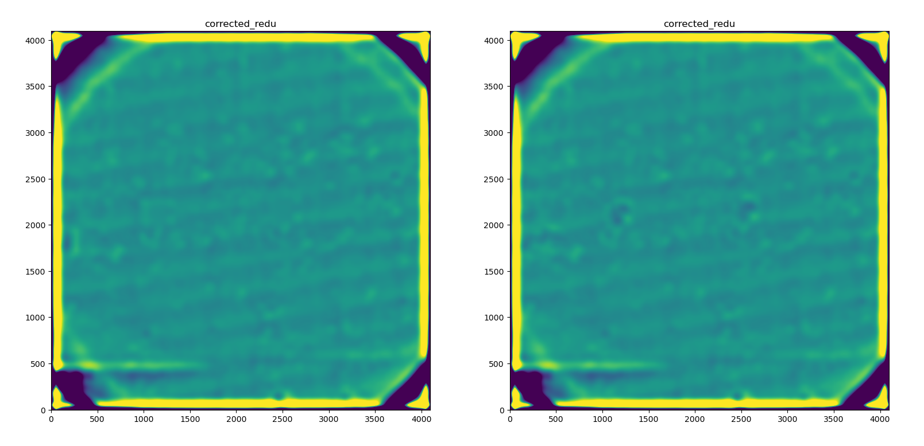
NB06 after major sunspot removal

Slide 3
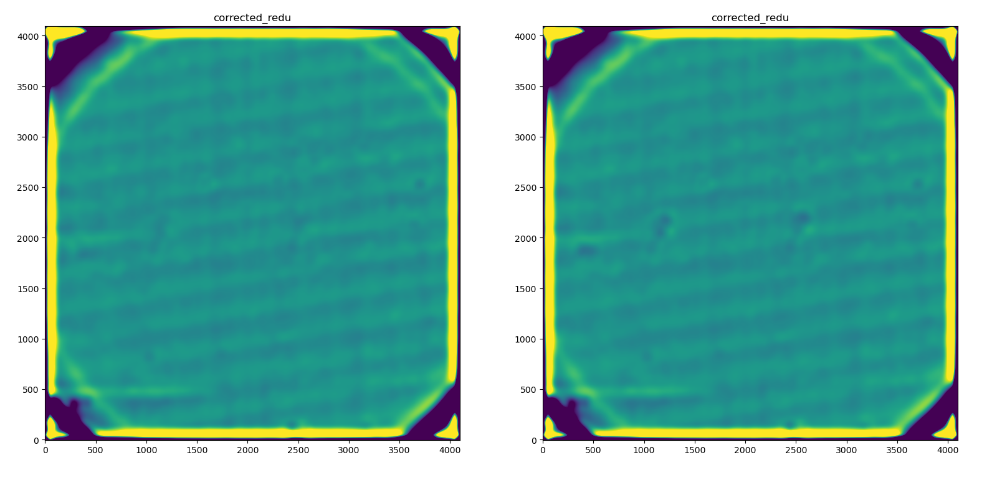
BB03 after major sunspot removal

Slide 4
Averaged image from each pointing Reduced Level 0 at SHTR_STR 0

Slide 5
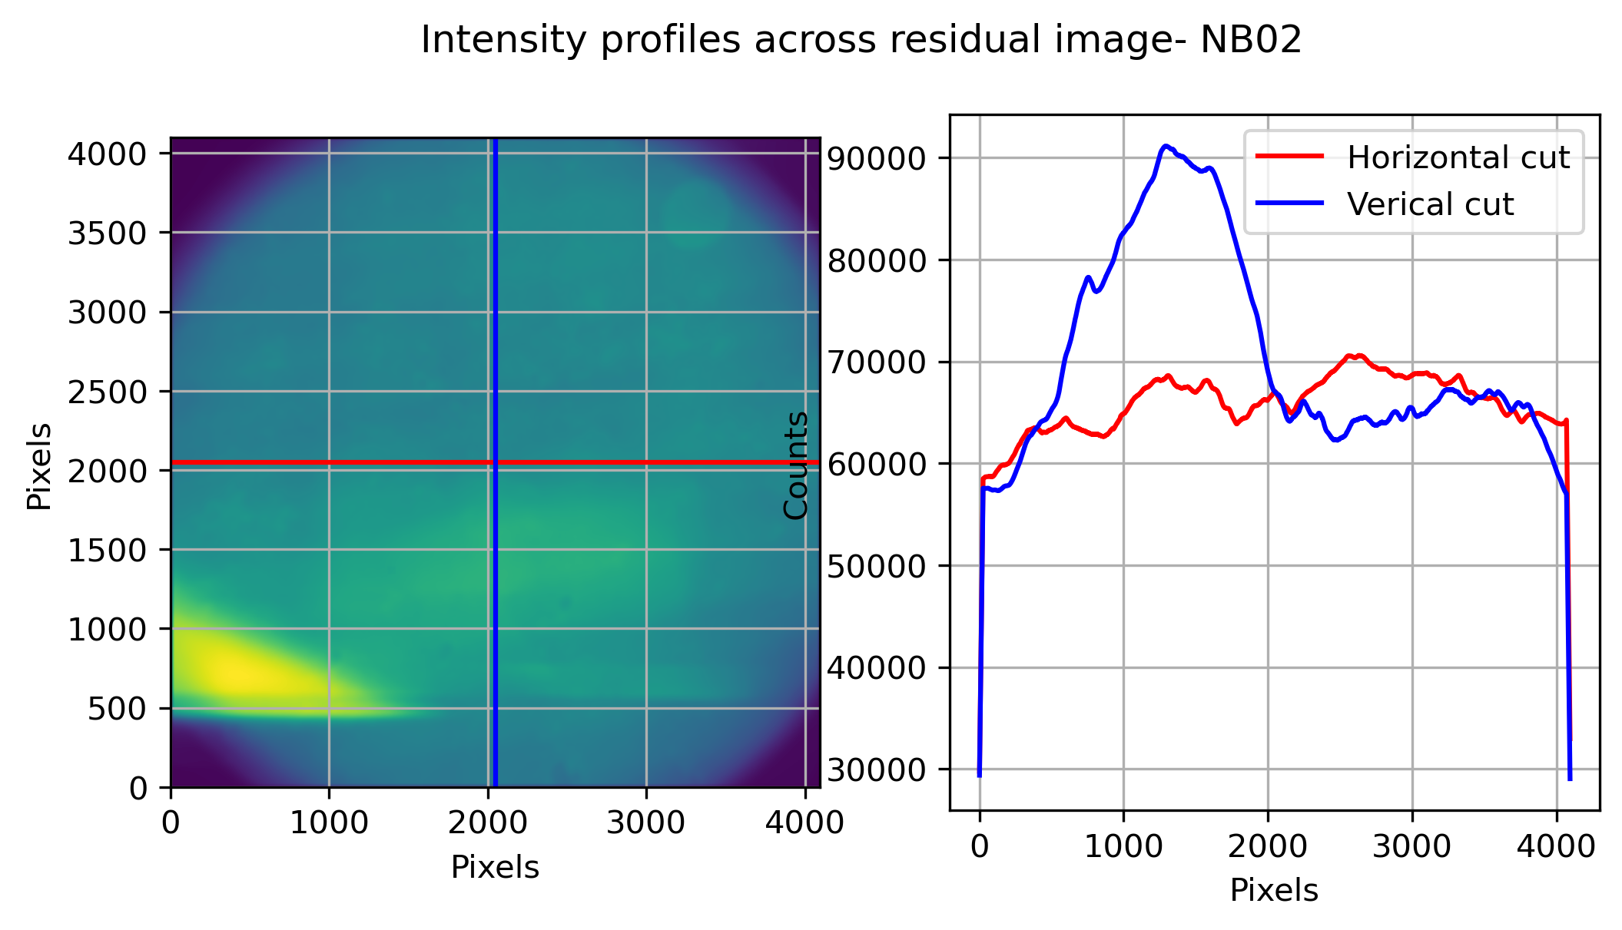
Scatter Corrected, Off sun Masked, Averaged image from each pointing
Reduced Level 0 at SHTR_STR 0
Pos(200px Box) %Std, Mean
(1000, 1000) (1.46, 81569.32)
(2000, 2000) (4.93, 69478.92)
(3000, 3000) (1.46, 65180.57)

Slide 6
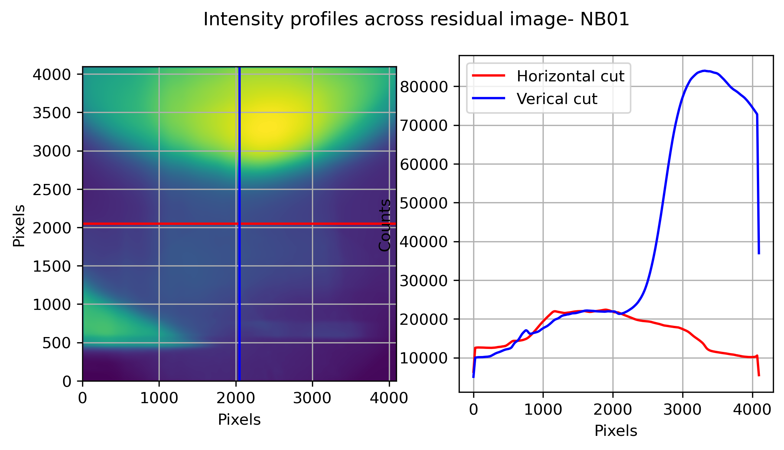
Averaged image from each pointing
Reduced Level 0 at SHTR_STR 0
Scattered light patterns are seen
Pos(200px Box) %Std, Mean
(1000, 1000) (3.7, 22223.18)
(2000, 2000) (1.59, 22007.31)
(3000, 3000) (10.6, 62516.01)

Slide 7
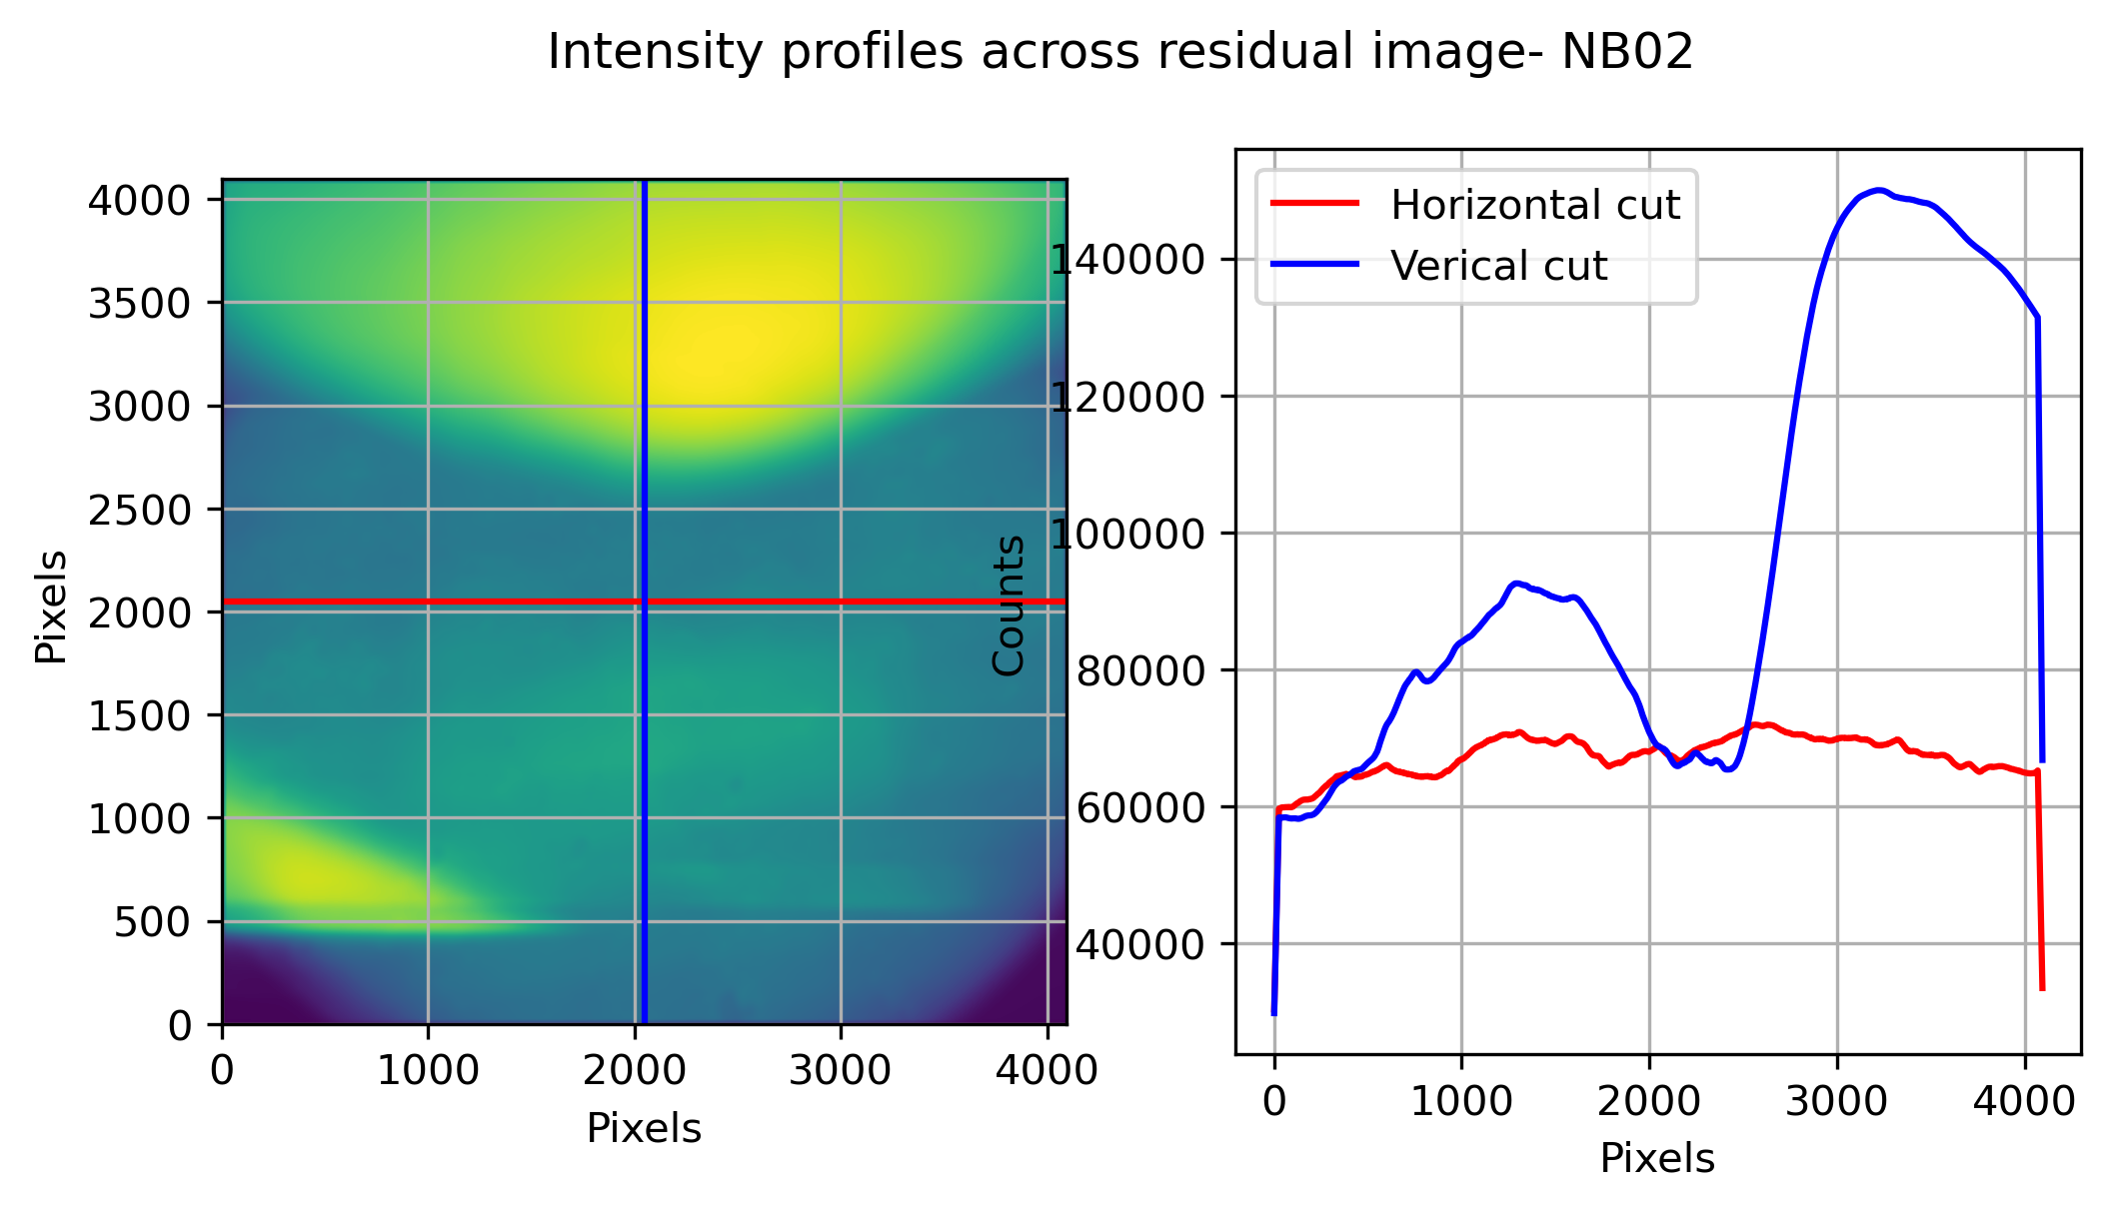
Averaged image from each pointing
Reduced Level 0 at SHTR_STR 0
2024-02-23
Scattered light patterns are seen
Pos(200px Box) %Std, Mean
(1000, 1000) (1.46, 83647.76)
(2000, 2000) (4.81, 71274.31)
(3000, 3000) (7.76, 123682.18)

Slide 8
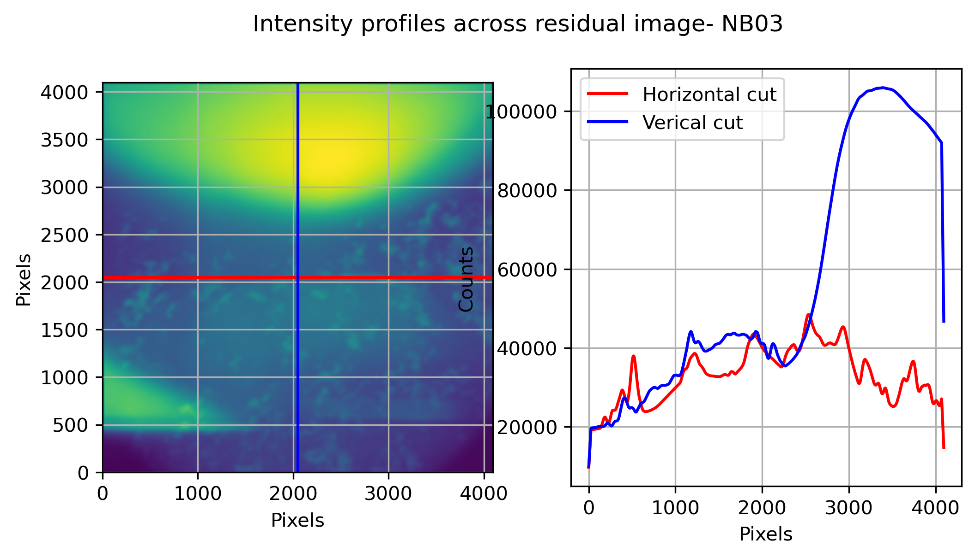
Averaged image from each pointing
Reduced Level 0 at SHTR_STR 0
Scattered light patterns are seen
Pos(200px Box) %Std, Mean
(1000, 1000) (2.27, 34620.35)
(2000, 2000) (6.95, 41804.28)
(3000, 3000) (9.65, 79824.78)

Slide 9
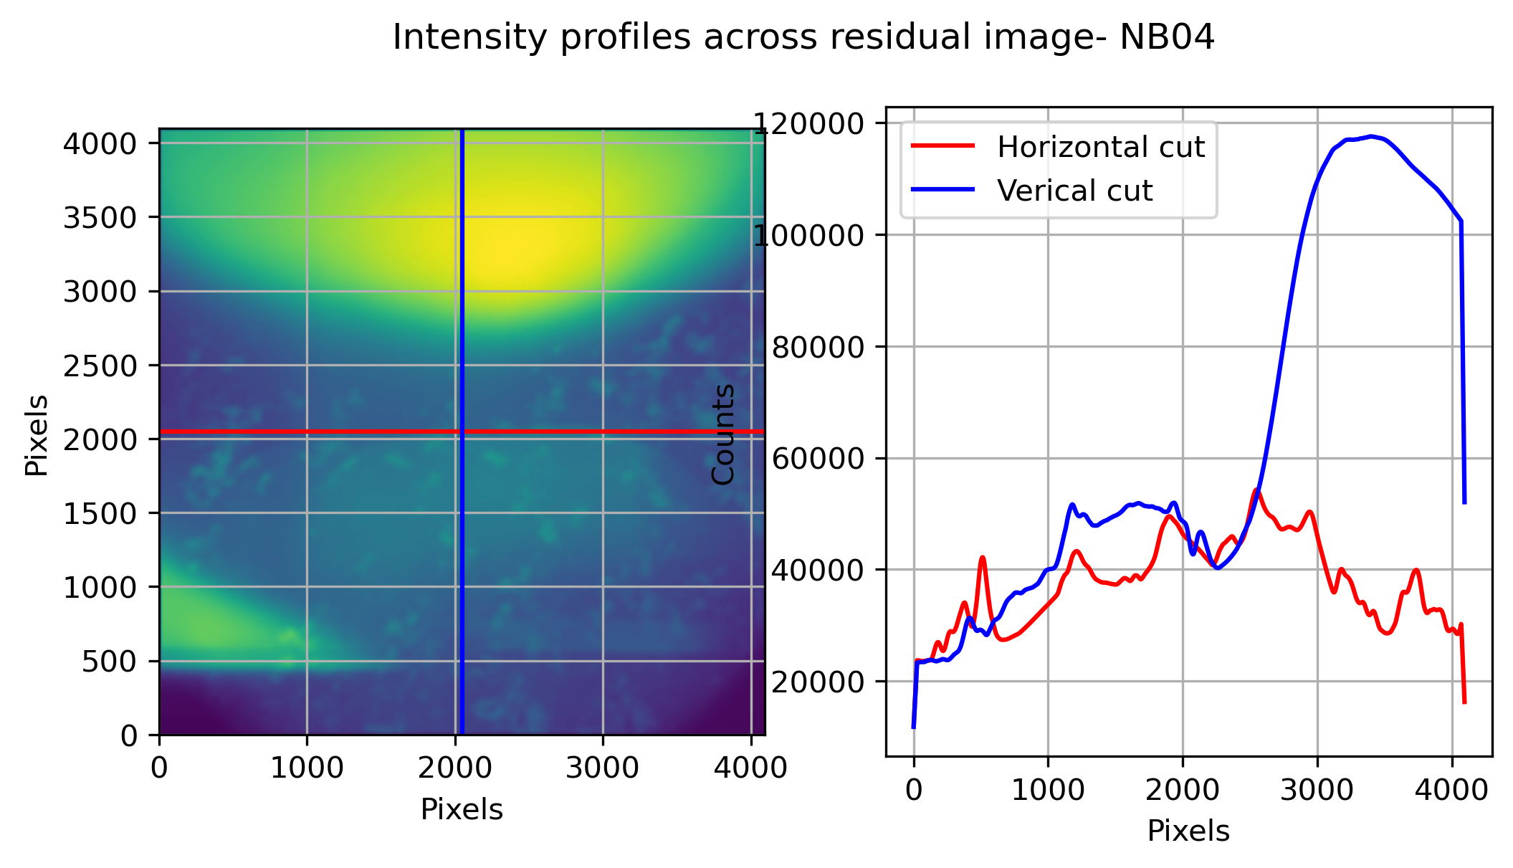
Averaged image from each pointing
Reduced Level 0 at SHTR_STR 0
Scattered light patterns are seen
Pos(200px Box) %Std, Mean
(1000, 1000) (2.16, 40765.44)
(2000, 2000) (7.31, 48696.84)
(3000, 3000) (9.22, 89945.89)

Slide 10
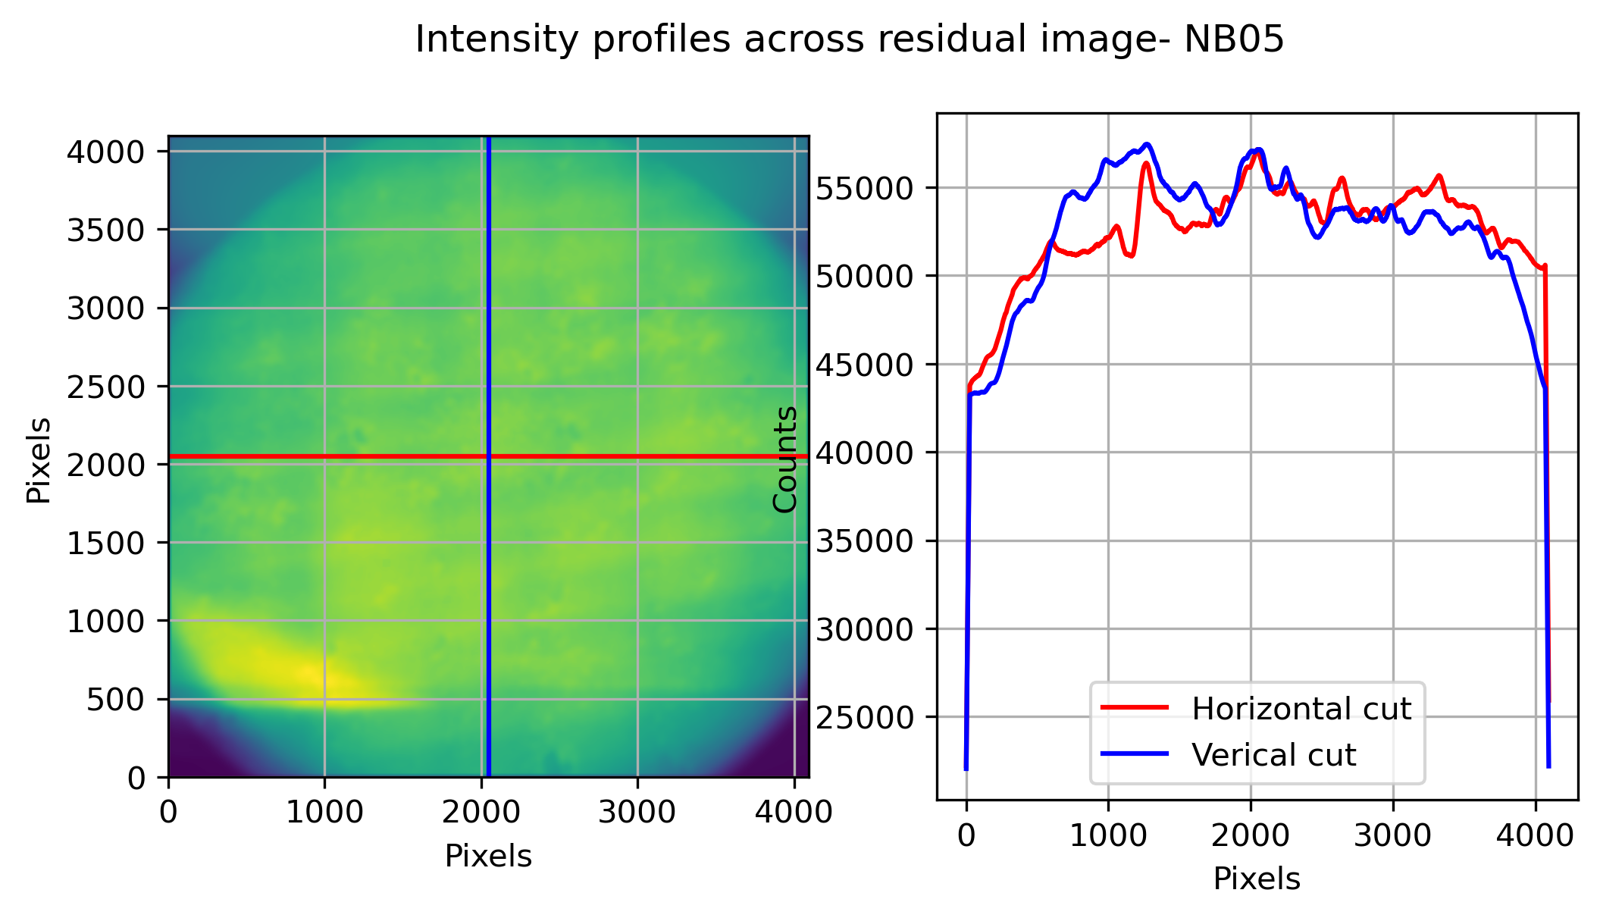
Averaged image from each pointing
Reduced Level 0 at SHTR_STR 0
2024-02-23
Scattered light patterns are seen
Pos(200px Box) %Std, Mean
(1000, 1000) (1.65, 54564.03)
(2000, 2000) (1.0, 55926.28)
(3000, 3000) (1.3, 51058.77)

Slide 11
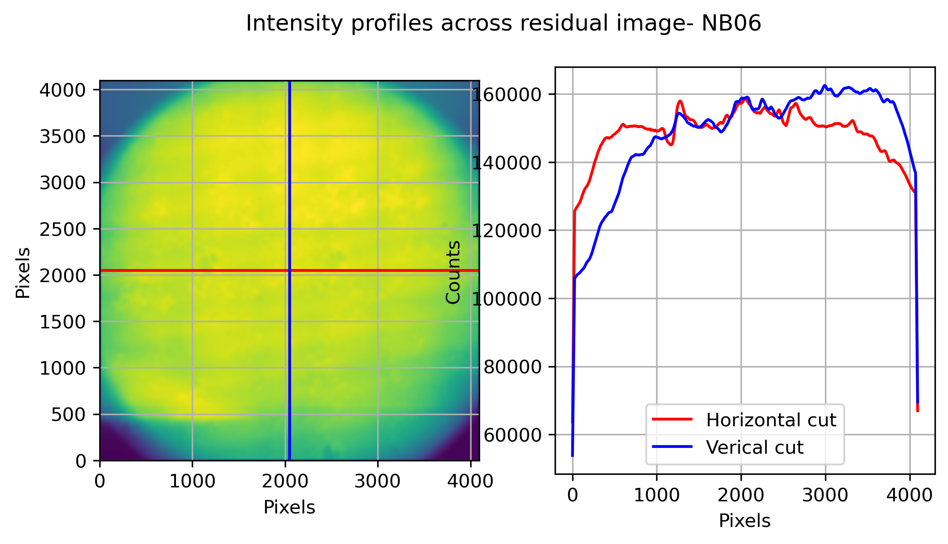
Averaged image from each pointing
Reduced Level 0 at SHTR_STR 0
2024-02-23
Pos(200px Box) %Std, Mean
(1000, 1000) (0.98, 143389.75)
(2000, 2000) (0.72, 156671.33)
(3000, 3000) (0.9, 152854.17)

Slide 12
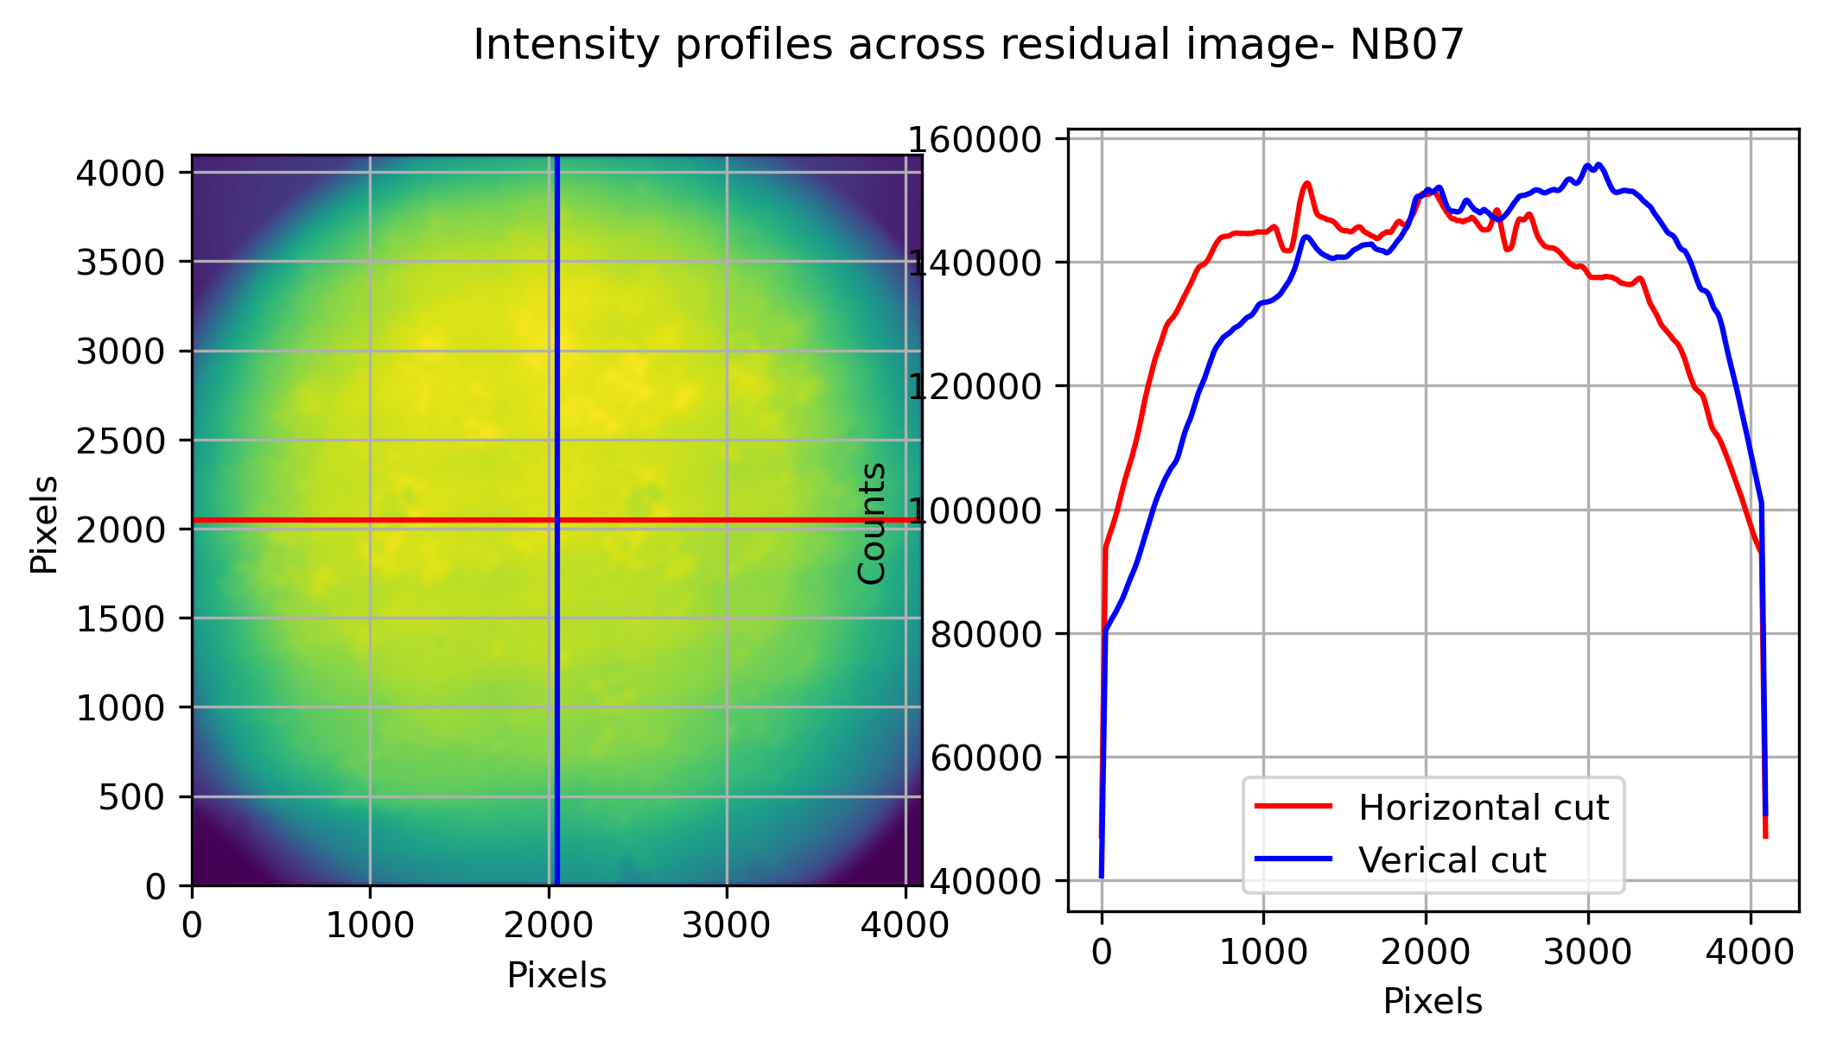
Averaged image from each pointing
Reduced Level 0 at SHTR_STR 0
Pos(200px Box) %Std, Mean
(1000, 1000) (1.58, 125766.05)
(2000, 2000) (0.89, 149453.36)
(3000, 3000) (1.73, 140172.97)

Slide 13
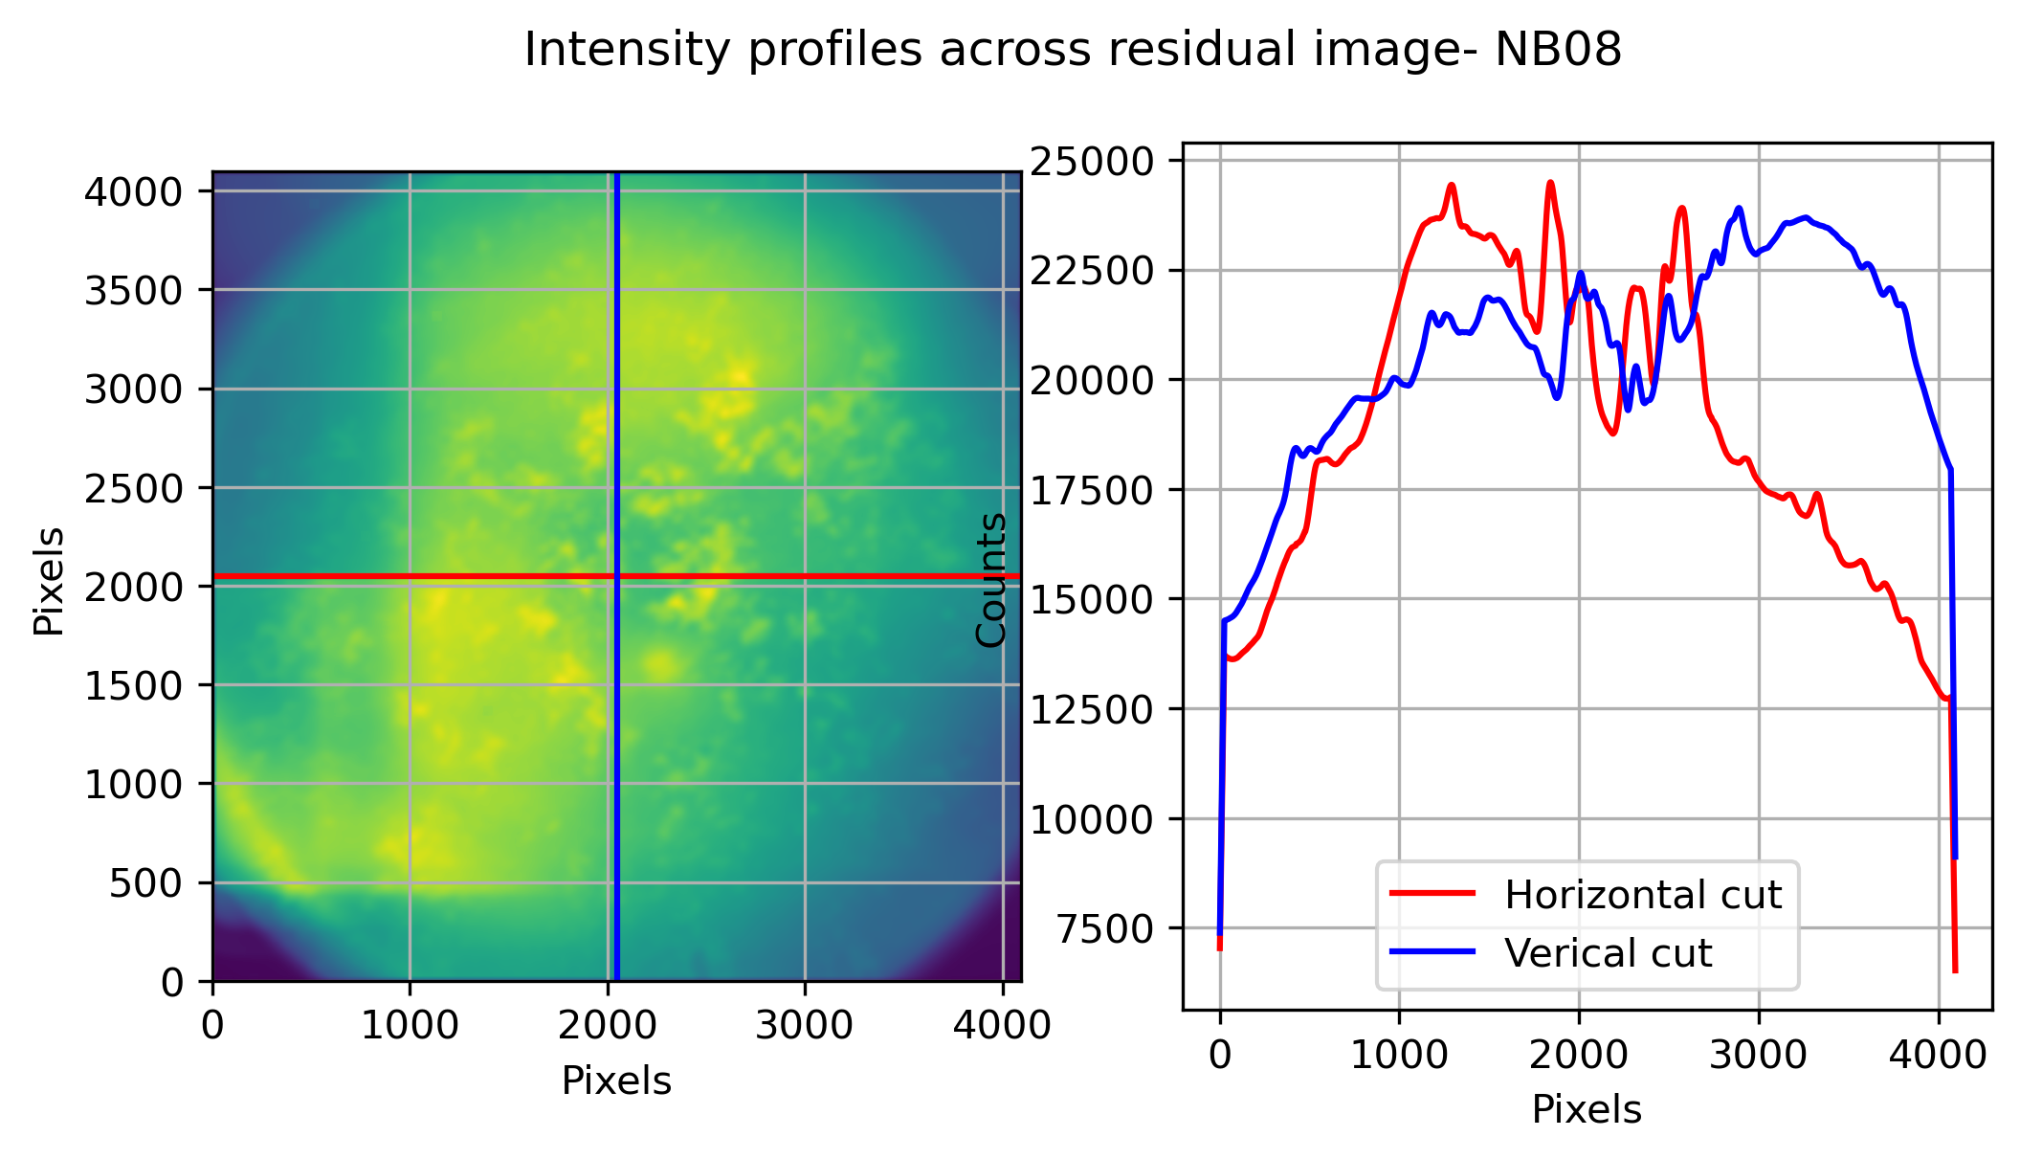
Averaged image from each pointing
Reduced Level 0 at SHTR_STR 0
Scattered light patterns are seen
Pos(200px Box) %Std, Mean
(1000, 1000) (2.12, 22447.16)
(2000, 2000) (3.62, 21421.9)
(3000, 3000) (2.48, 20968.33)

Slide 14
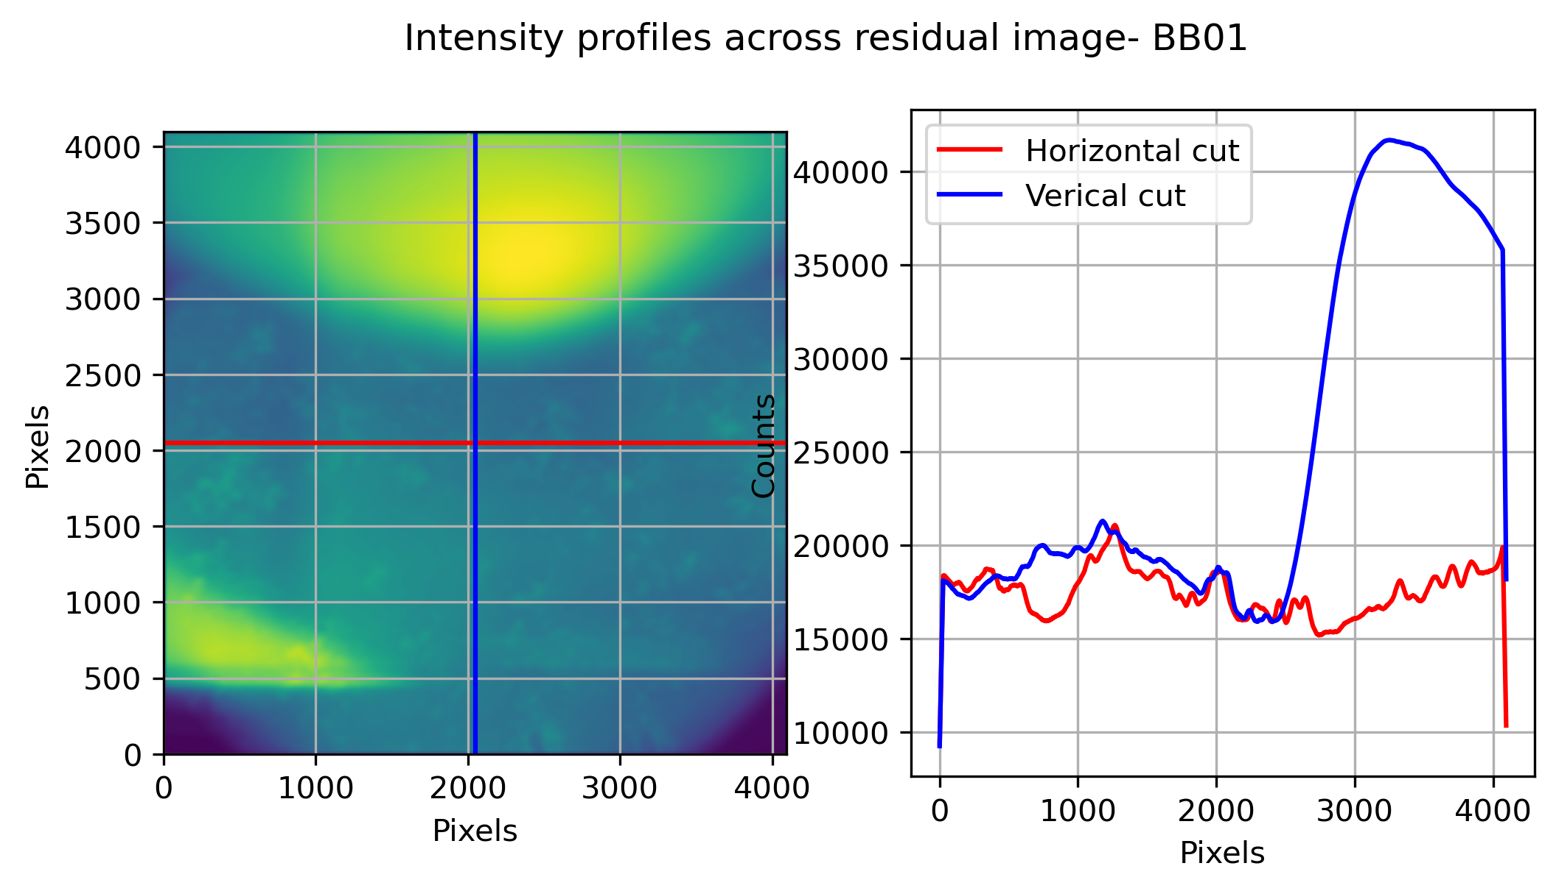
Averaged image from each pointing
Reduced Level 0 at SHTR_STR 0
Scattered light patterns are seen
Pos(200px Box) %Std, Mean
(1000, 1000) (2.46, 23212.81)
(2000, 2000) (2.49, 17927.63)
(3000, 3000) (10.24, 30752.14)

Slide 15
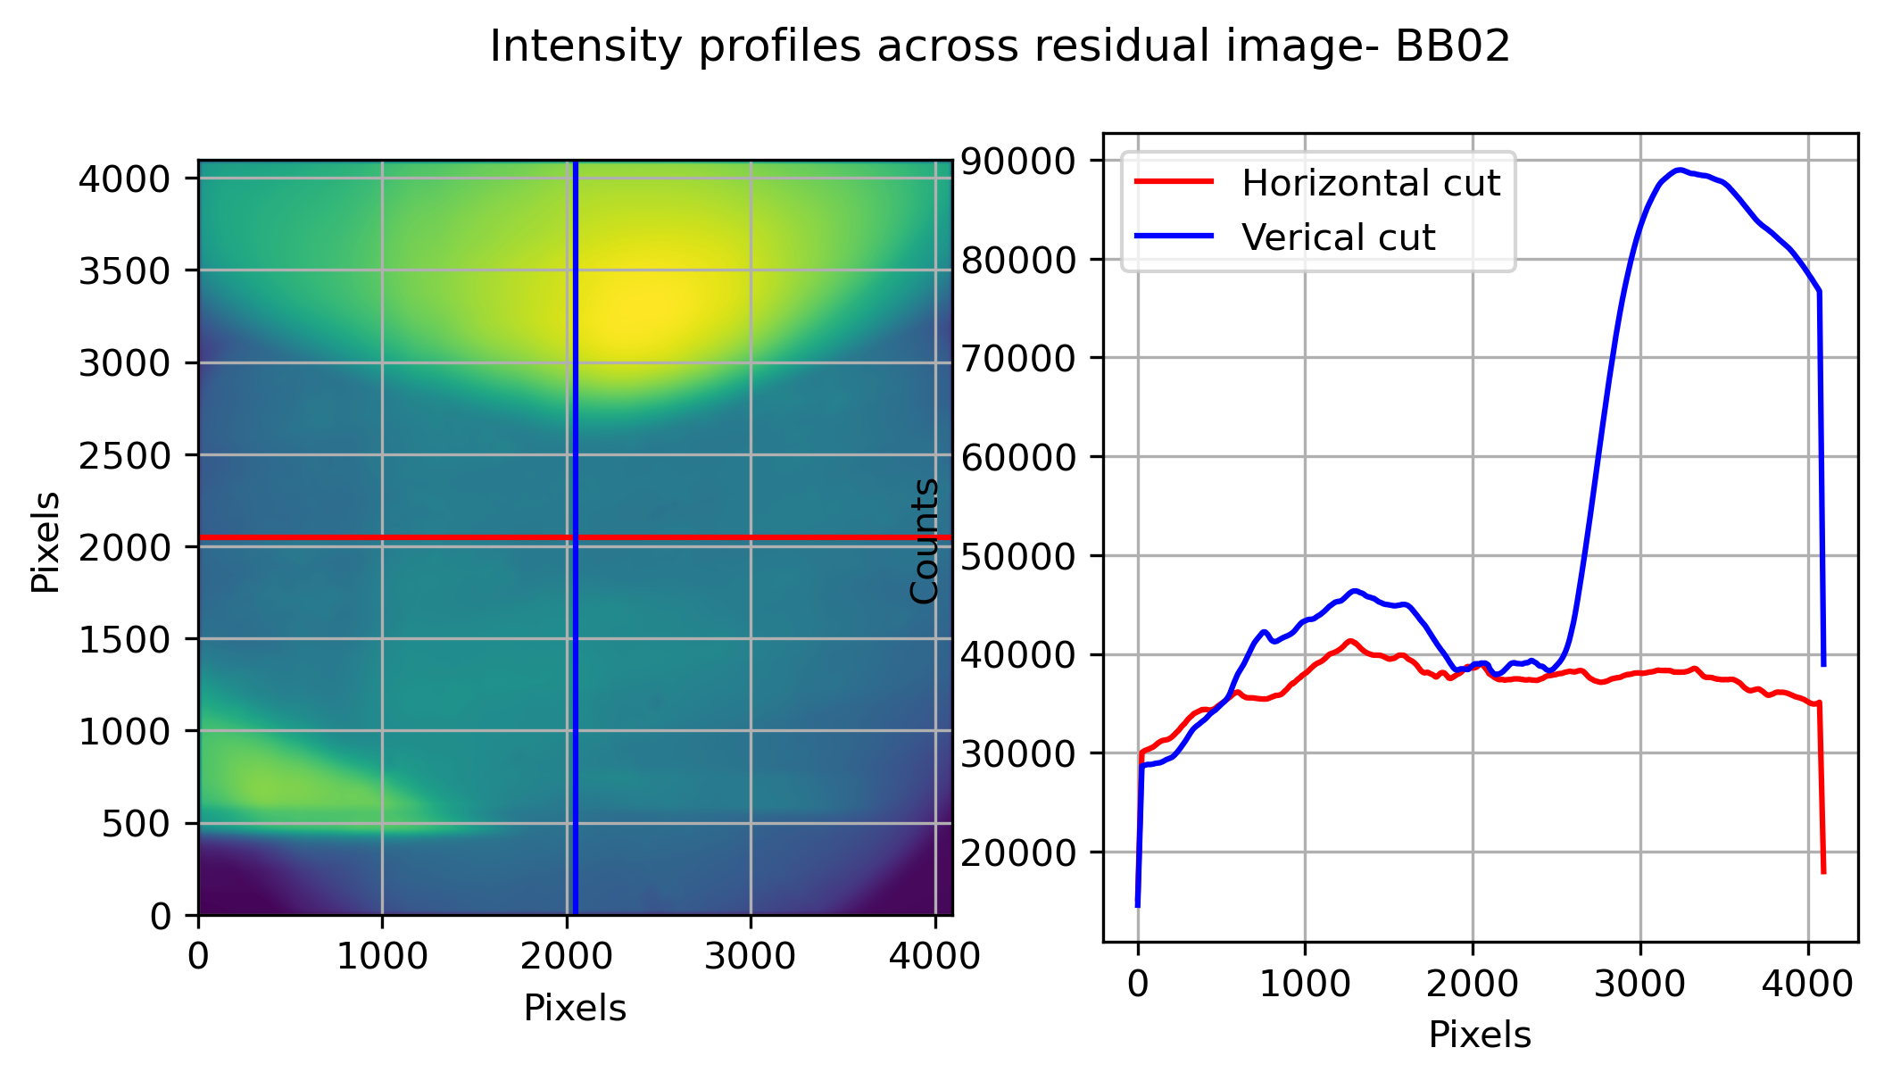
Averaged image from each pointing
Reduced Level 0 at SHTR_STR 0
Scattered light patterns are seen
Pos(200px Box) %Std, Mean
(1000, 1000) (1.99, 45200.12)
(2000, 2000) (0.68, 38438.08)
(3000, 3000) (10.31, 66723.45)

Slide 16
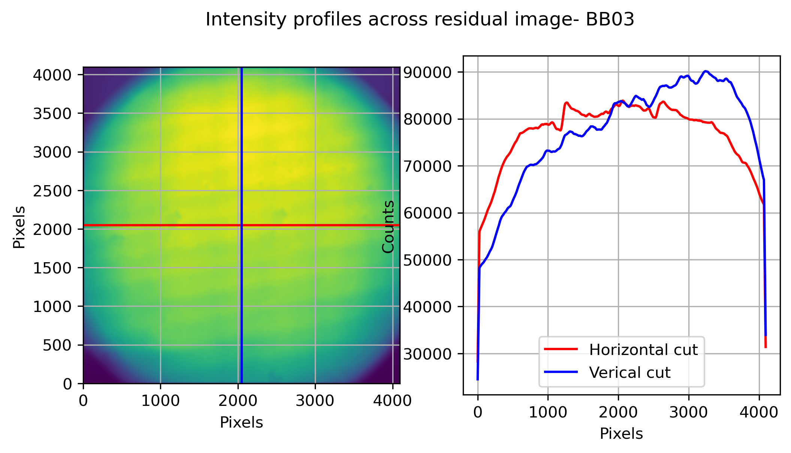
Averaged image from each pointing
Reduced Level 0 at SHTR_STR 0
2024-02-23
Pos(200px Box) %Std, Mean
(1000, 1000) (1.43, 69159.4)
(2000, 2000) (0.6, 82815.08)
(3000, 3000) (1.17, 83064.39)

Slide 17
Single frame from each pointing Lvl 0 at SHTR_STR 0

Slide 18
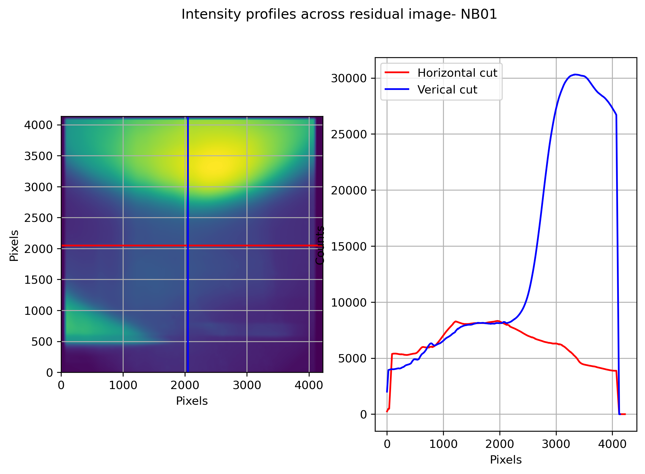
Single frame from each pointing
Lvl 0 at SHTR_STR 0
2024-02-17
Pos(200px Box) %Std, Mean
(1000, 1000) (7.0, 7974.58)
(2000, 2000) (1.07, 8189.51)
(3000, 3000) (10.29, 23043.27)
Highly dominated by scattered light.

Slide 19
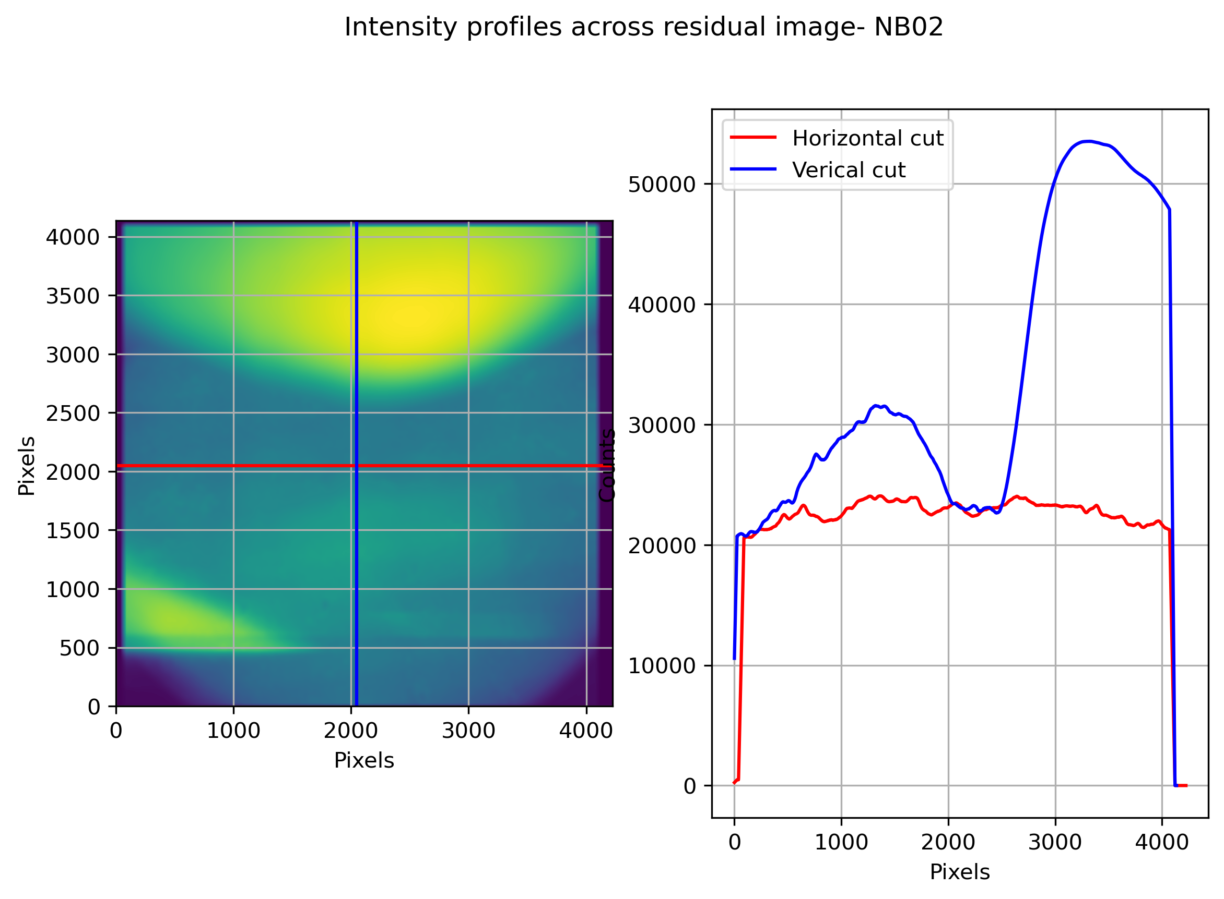
Single frame from each pointing
Lvl 0 at SHTR_STR 0
2024-02-17
Pos(200px Box) %Std, Mean
(1000, 1000) (3.04, 28140.22)
(2000, 2000) (4.59, 24309.99)
(3000, 3000) (7.34, 45145.76)
Highly dominated by scattered light.

Slide 20
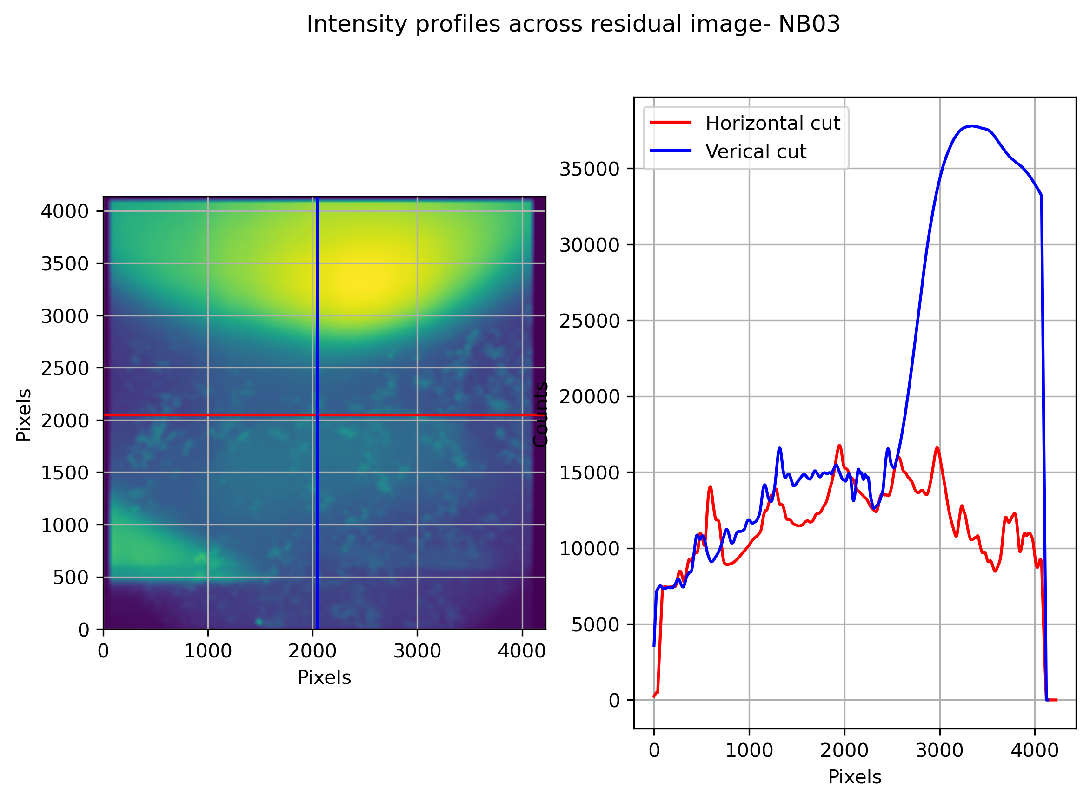
Single frame from each pointing
Lvl 0 at SHTR_STR 0
2024-02-17
Pos(200px Box) %Std, Mean
(1000, 1000) (3.55, 12167.99)
(2000, 2000) (6.85, 15331.22)
(3000, 3000) (9.29, 29439.29)
Highly dominated by scattered light.

Slide 21
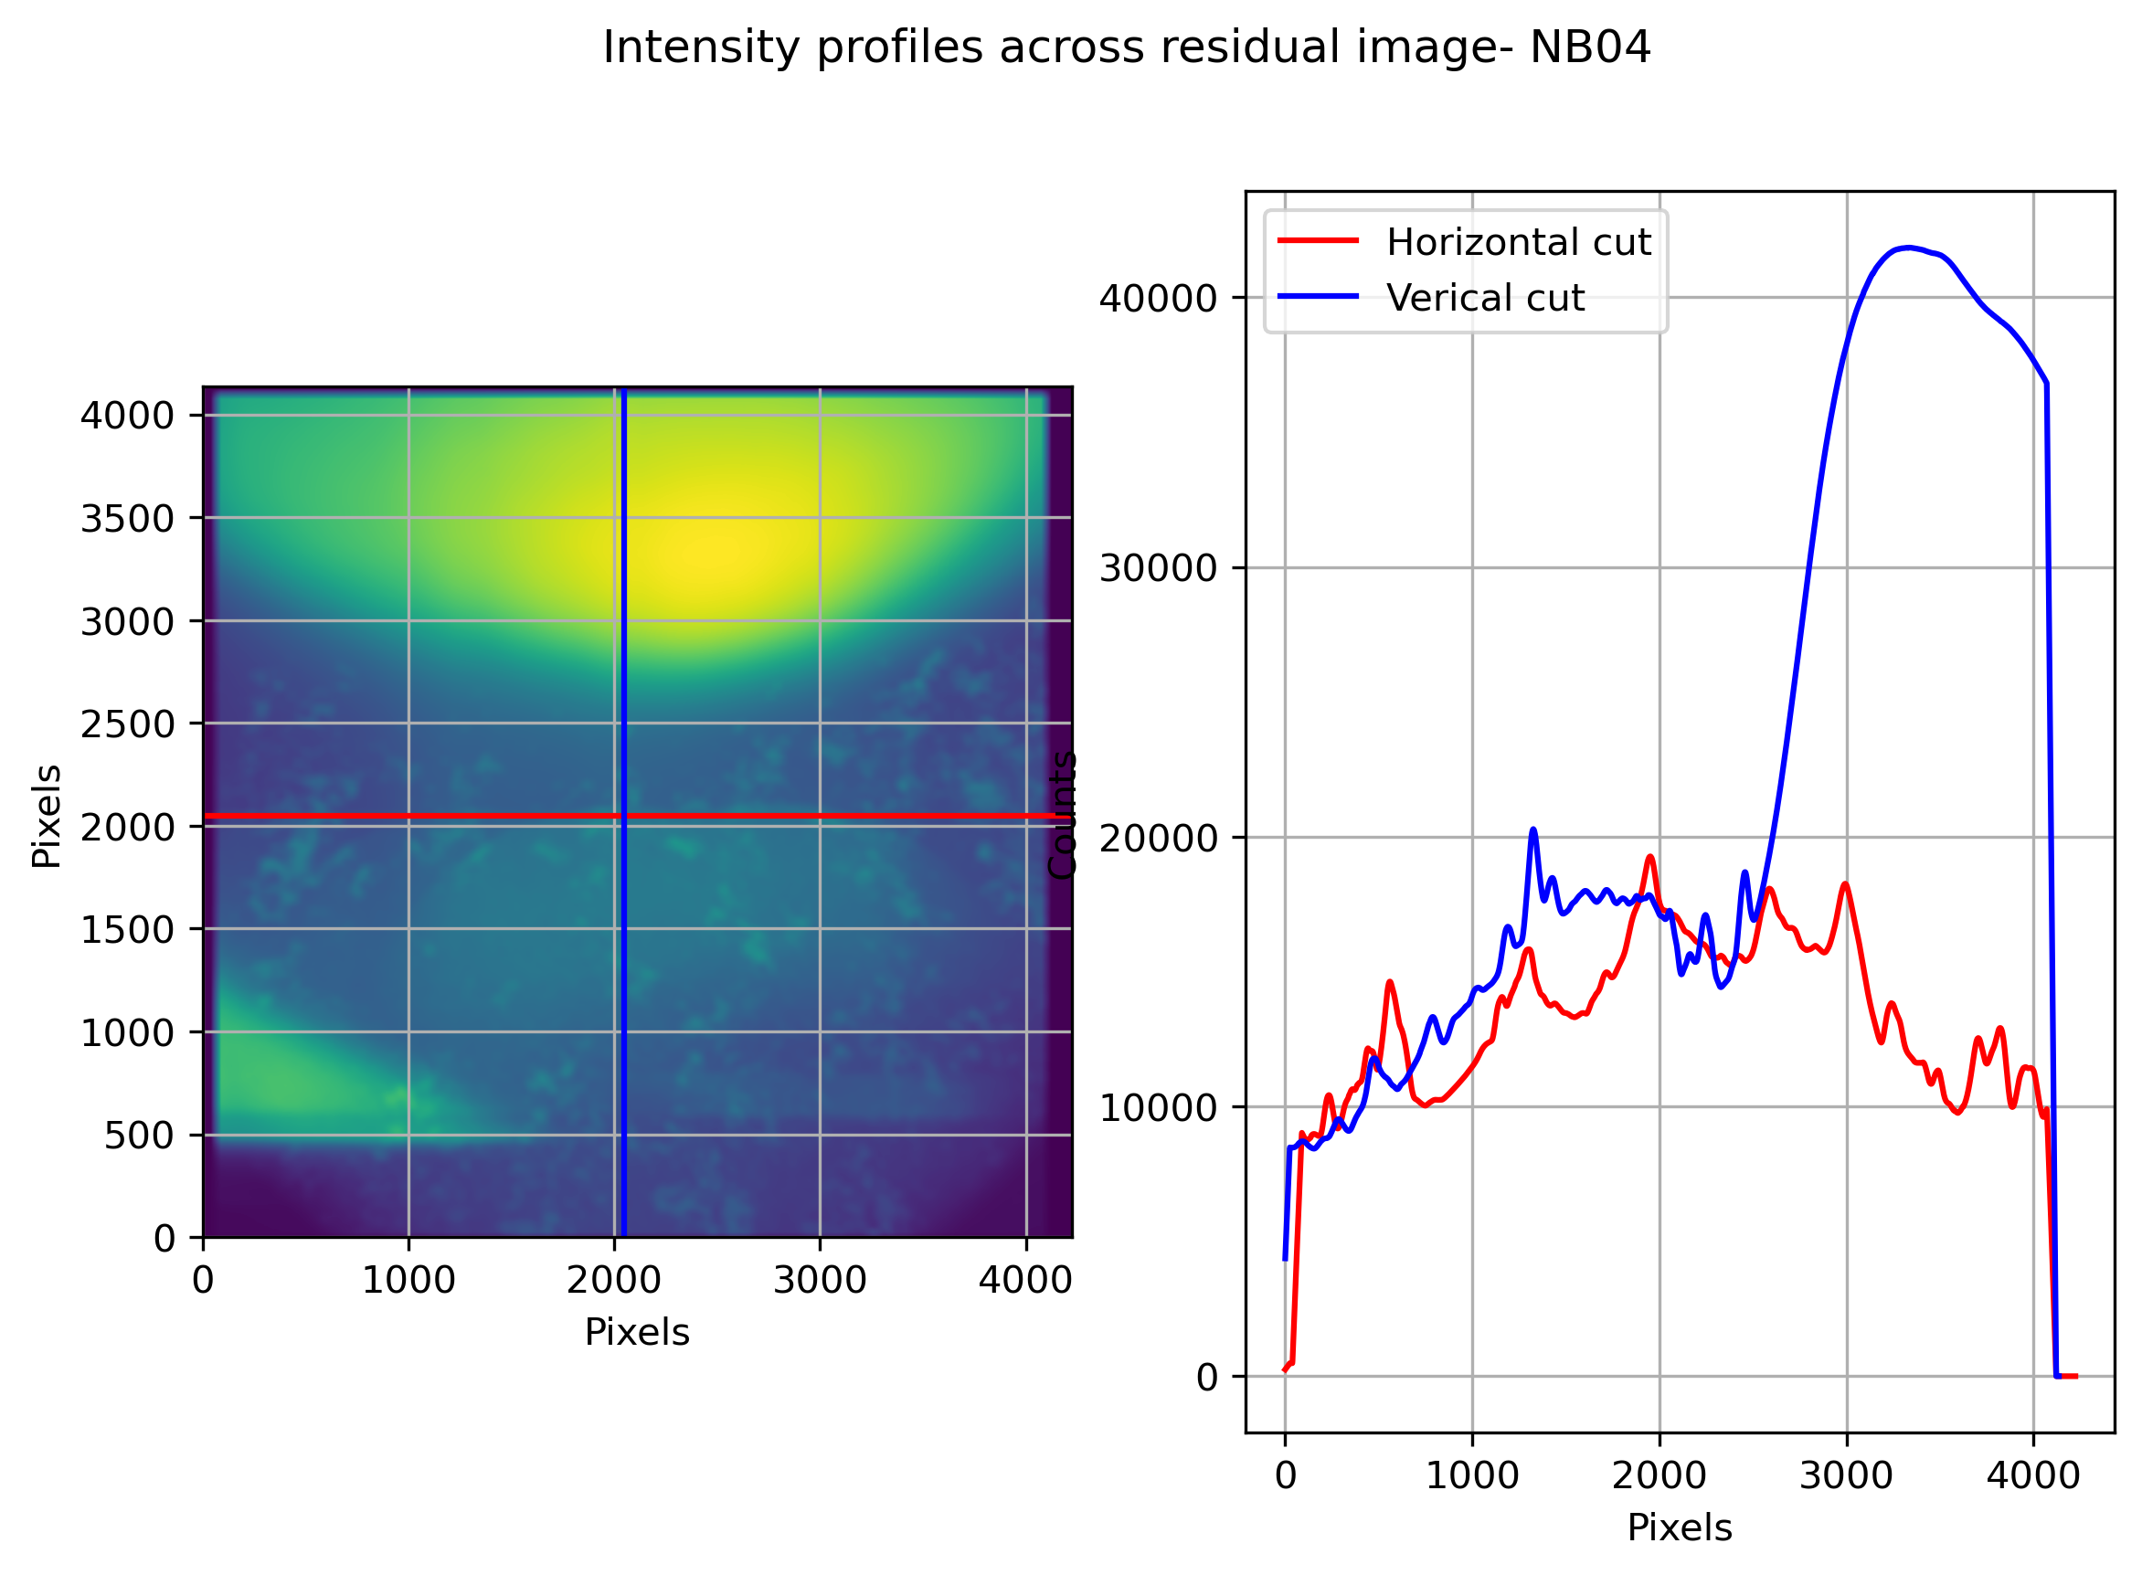
Single frame from each pointing
Lvl 0 at SHTR_STR 0
2024-02-17
Pos(200px Box) %Std, Mean
(1000, 1000) (3.48, 14151.82)
(2000, 2000) (5.58, 17776.46)
(3000, 3000) (8.87, 32895.68)
Highly dominated by scattered light.

Slide 22
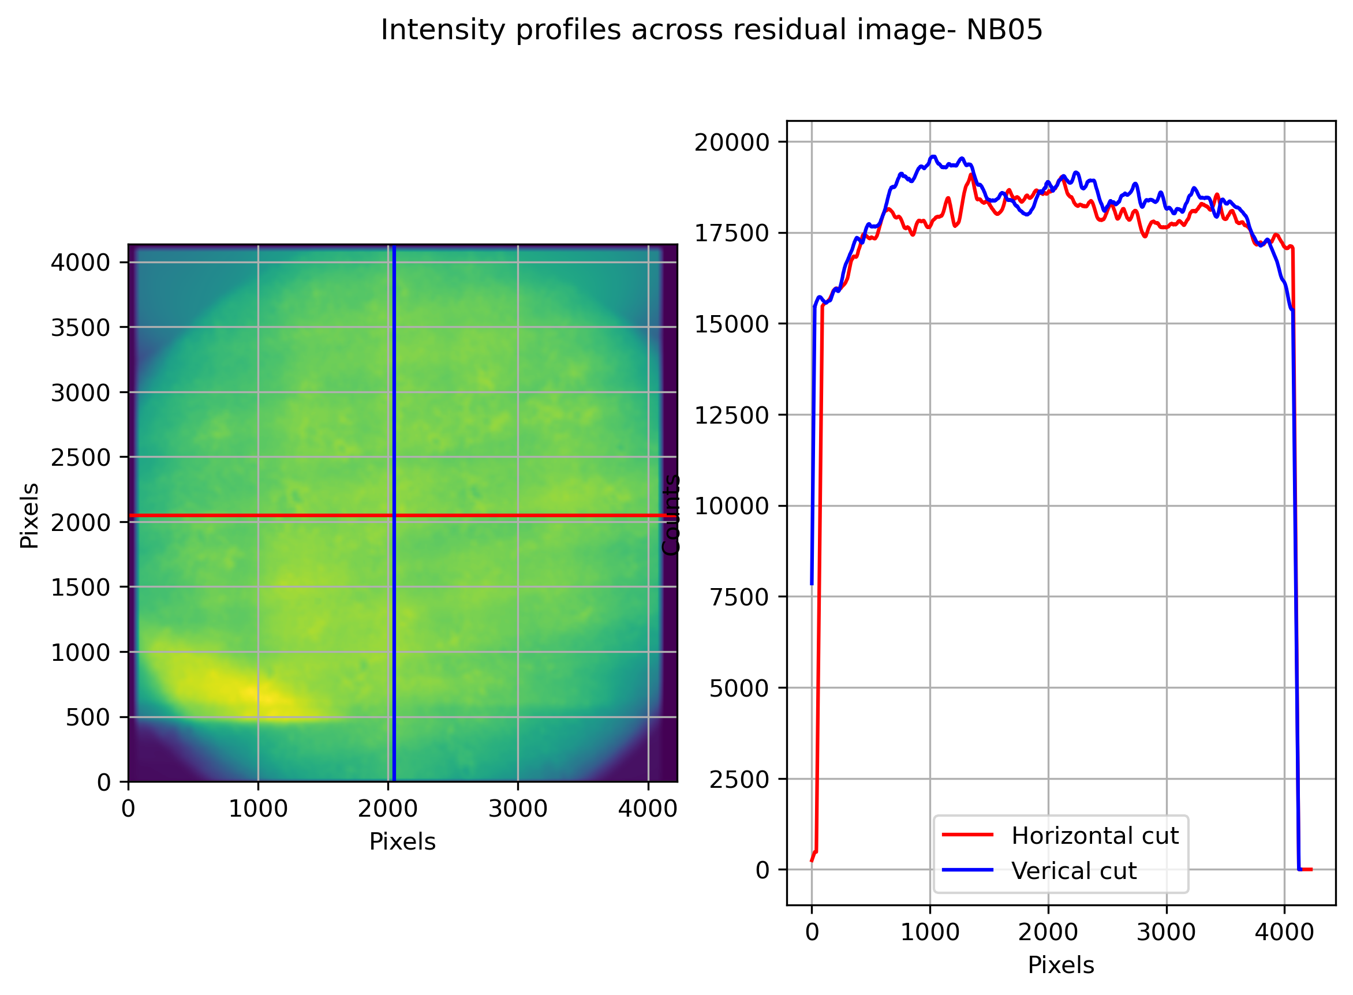
Single frame from each pointing
Lvl 0 at SHTR_STR 0
2024-02-17
Pos(200px Box) %Std Mean
(1000, 1000) (1.96, 18260.97)
(2000, 2000) (1.06, 18783.25)
(3000, 3000) (1.45, 17592.7)

Slide 23
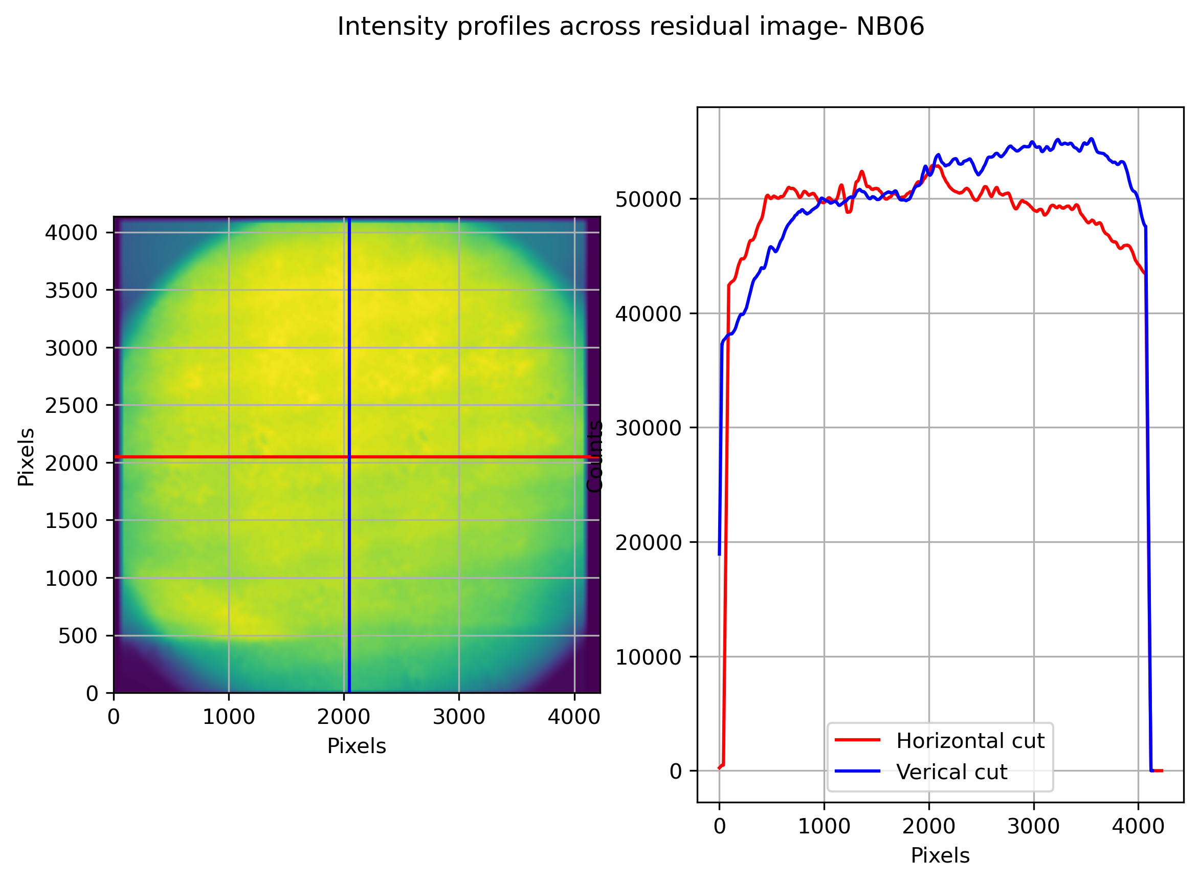
Single frame from each pointing
Lvl 0 at SHTR_STR 0
2024-02-17
Pos(200px Box) %Std Mean
(1000, 1000) (0.84, 47499.1)
(2000, 2000) (1.33, 52150.1)
(3000, 3000) (1.03, 51497.82)

Slide 24
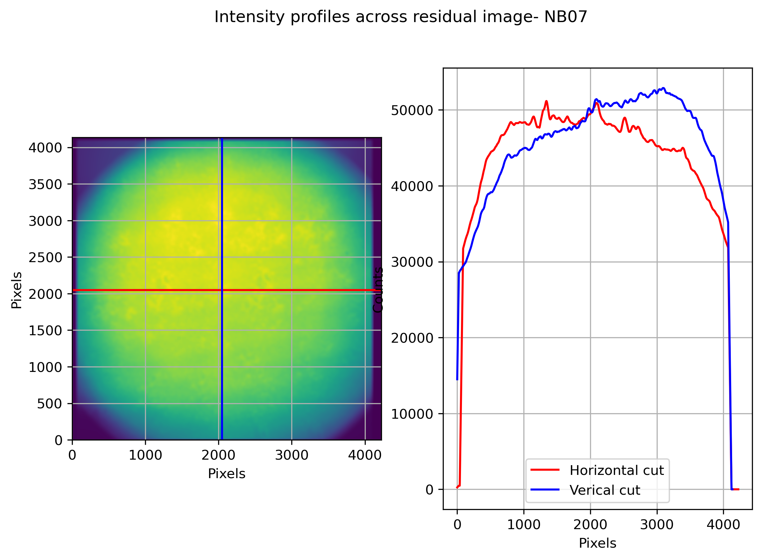
Single frame from each pointing
Lvl 0 at SHTR_STR 0
2024-02-17
Pos(200px Box) %Std, Mean
(1000, 1000) (1.46, 41336.22)
(2000, 2000) (1.43, 49594.28)
(3000, 3000) (1.43, 47717.86)

Slide 25
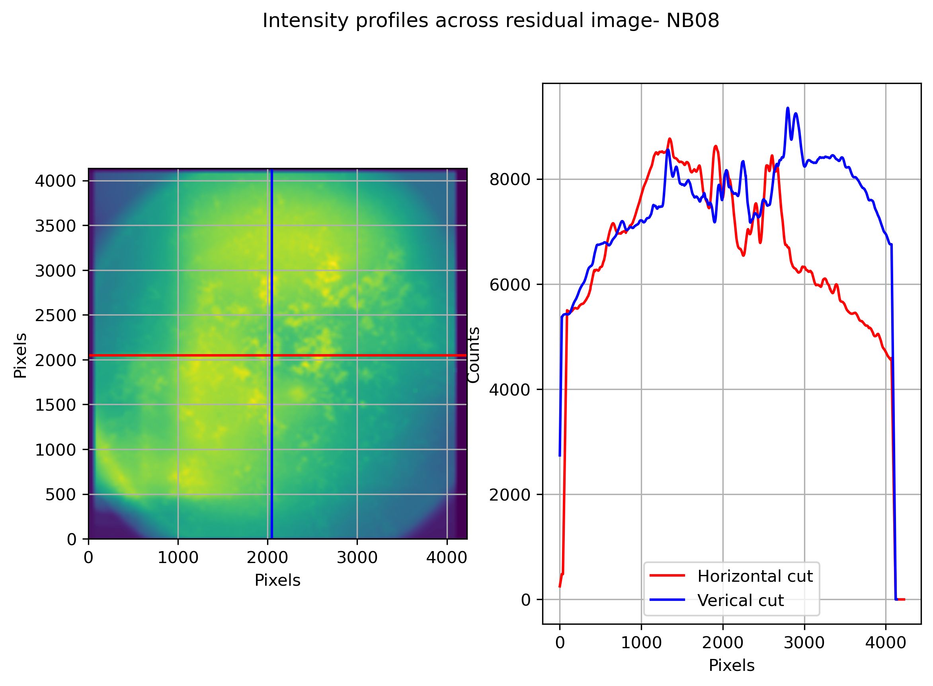
Single frame from each pointing
Lvl 0 at SHTR_STR 0
2024-02-17
Pos(200px Box) %Std, Mean
(1000, 1000) (2.56, 7720.36)
(2000, 2000) (4.23, 7861.74)
(3000, 3000) (2.44, 7554.5)

Slide 26
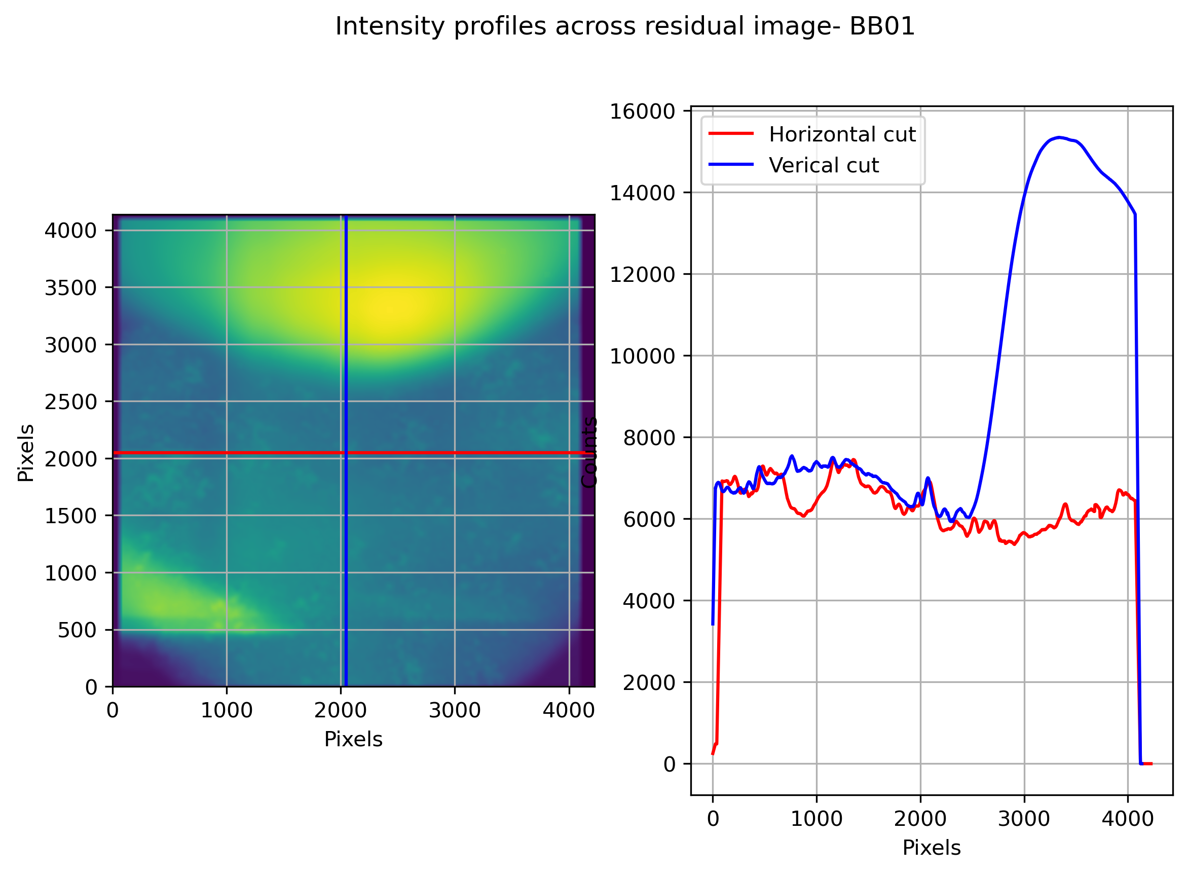
Single frame from each pointing
Lvl 0 at SHTR_STR 0
2024-02-17
Pos(200px Box) %Std, Mean
(1000, 1000) (3.91, 8134.45)
(2000, 2000) (2.94, 6481.17)
(3000, 3000) (9.74, 11672.7)
Highly dominated by scattered light.

Slide 27
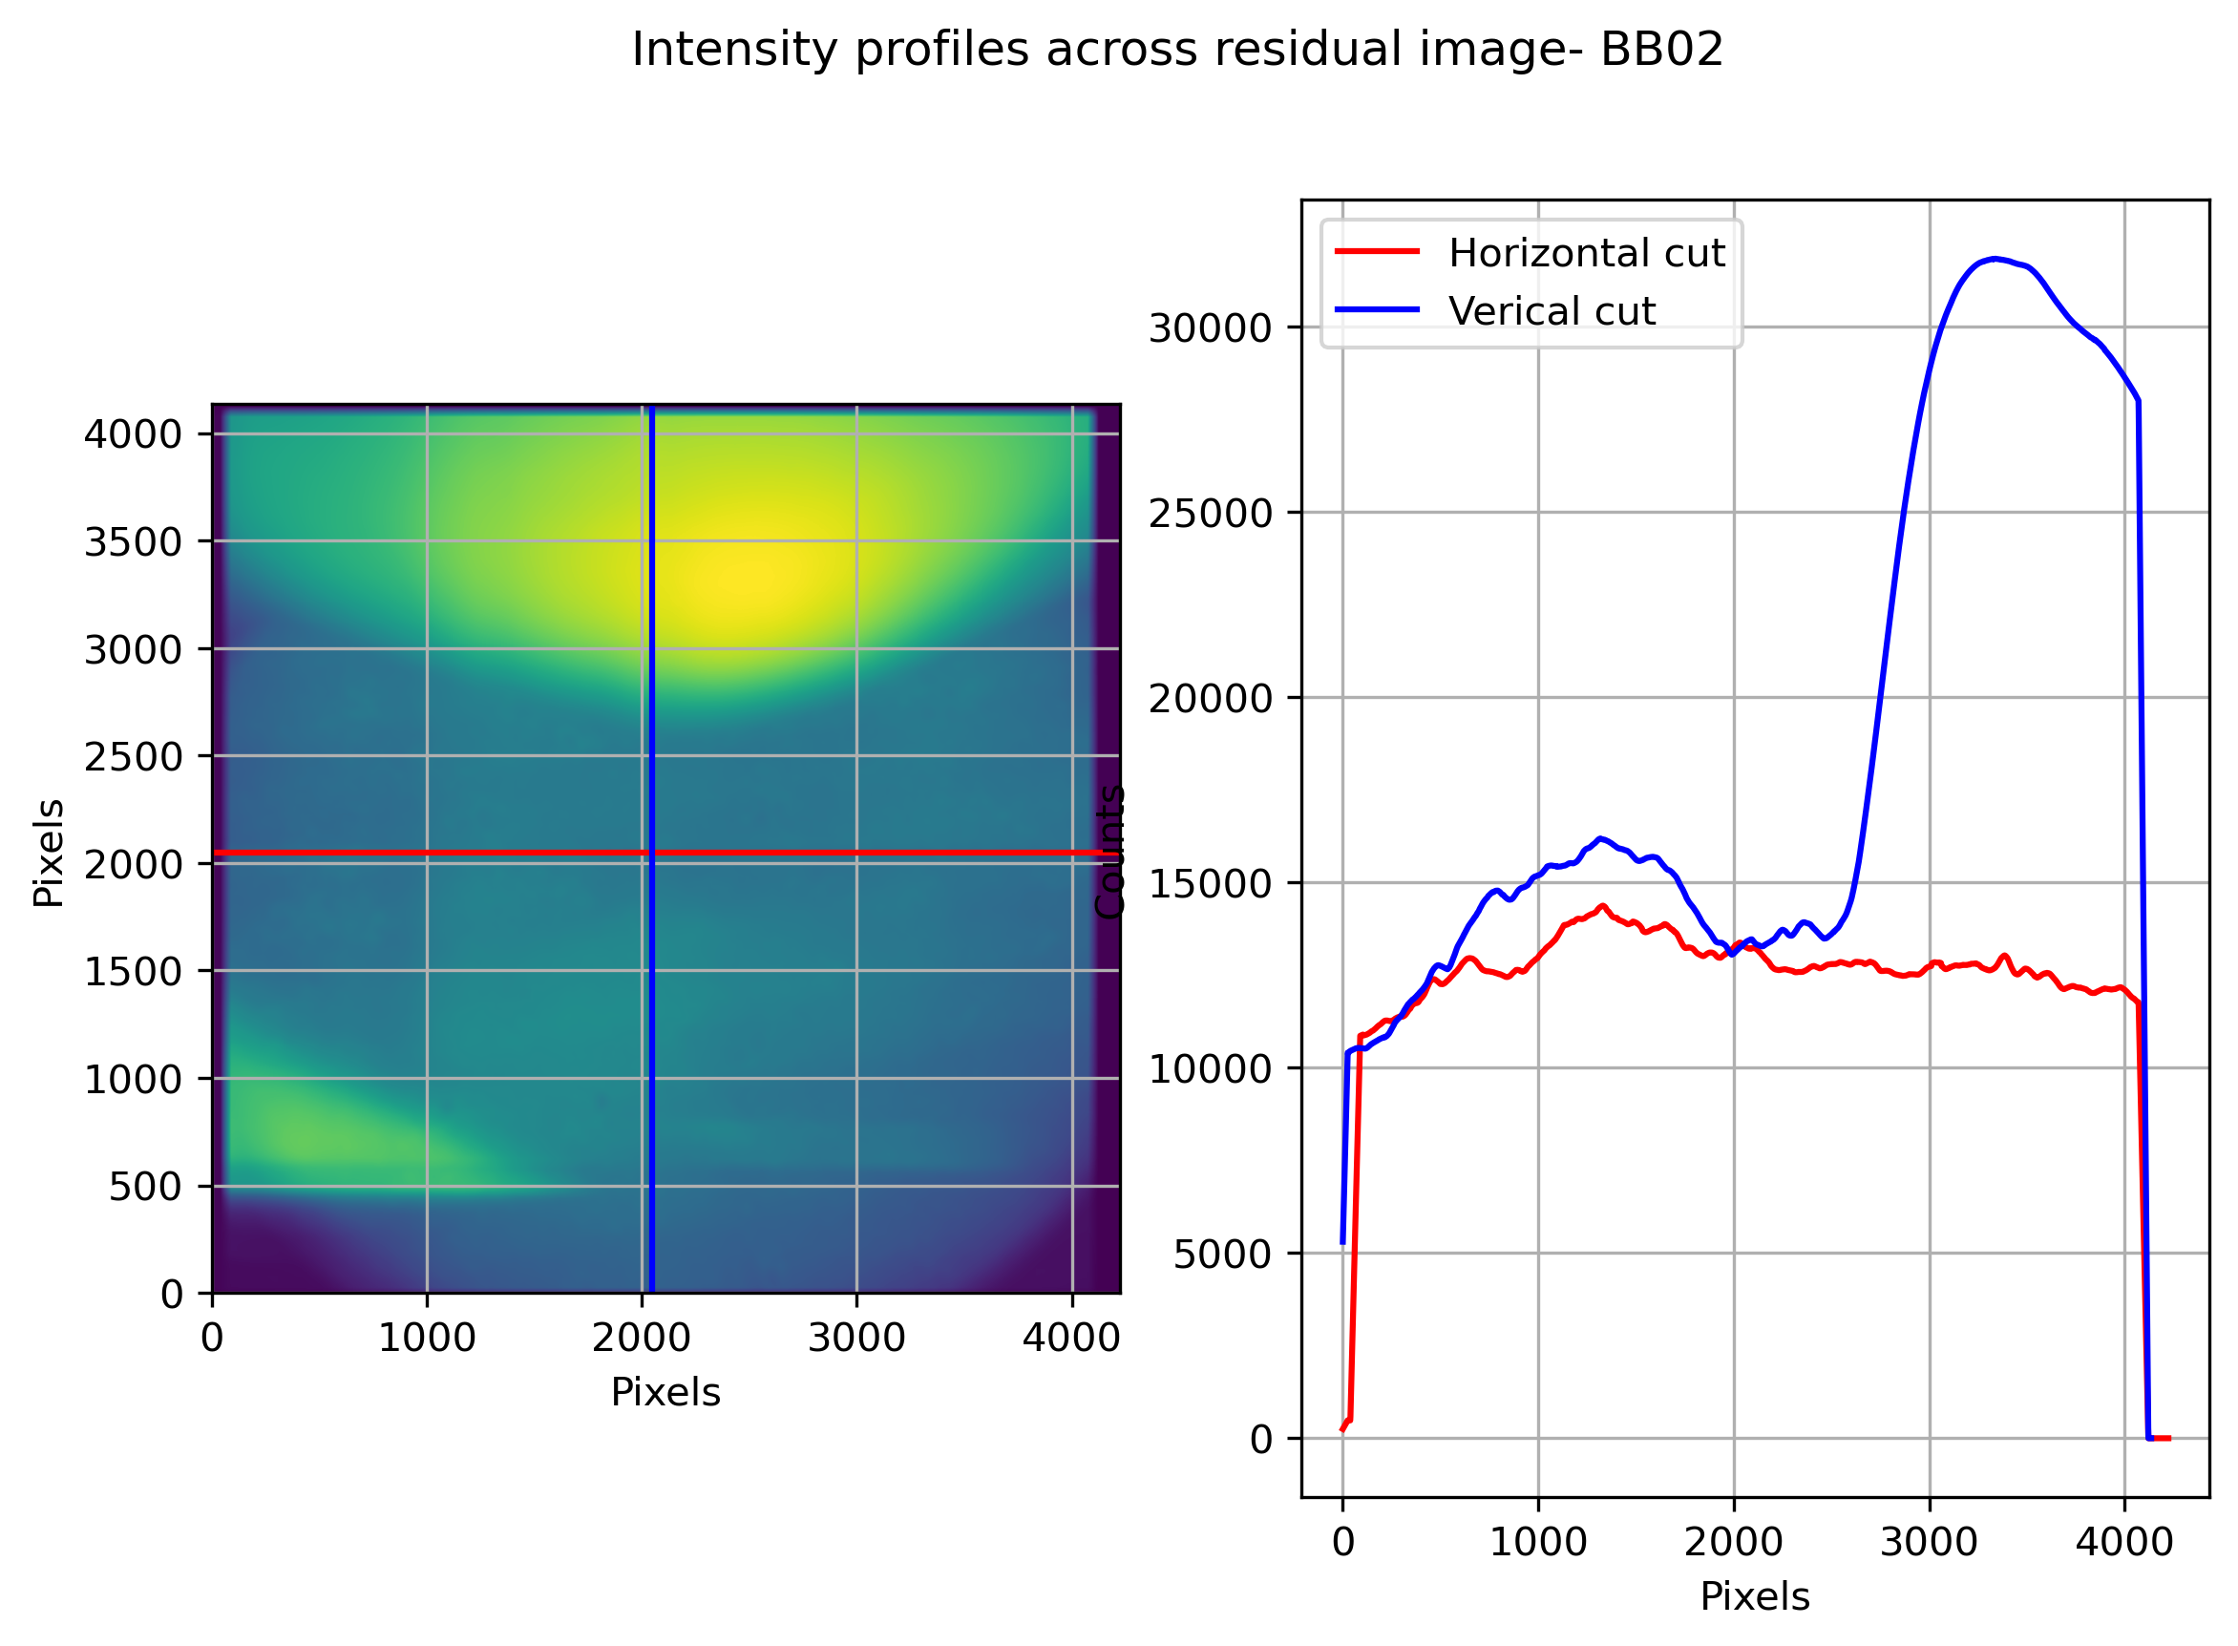
Single frame from each pointing
Lvl 0 at SHTR_STR 0
2024-02-17
Pos(200px Box) %Std, Mean
(1000, 1000) (3.53, 15295.68)
(2000, 2000) (1.03, 13247.64)
(3000, 3000) (10.04, 24427.43)
Highly dominated by scattered light.

Slide 28
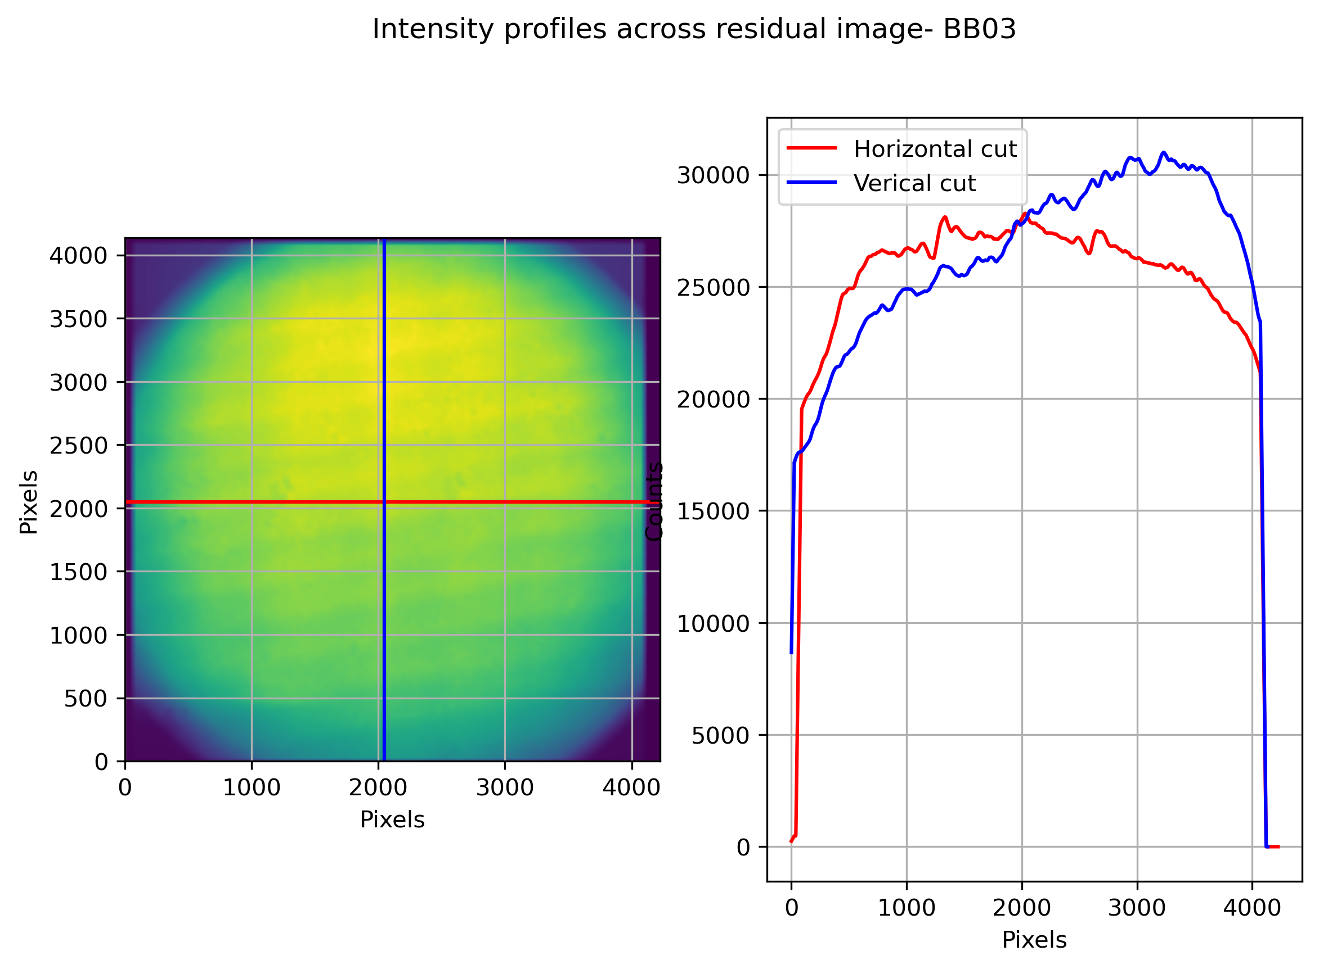
Single frame from each pointing
Lvl 0 at SHTR_STR 0
2024-02-17
Pos(200px Box) %Std, Mean
(1000, 1000) (1.13, 22927.61)
(2000, 2000) (1.21, 27771.58)
(3000, 3000) (1.14, 28401.48)

